Slide 1
Introduction to Kubernetes
Install Kubernetes
Kubectl CLI - Common commands
Pods, Deployment, ReplicaSets
Scaling your applications

Slide 2
Talk about...
Explain containers.
Why K8s came into picture?
Give an example of an app that became containerized and then grew complex. This needed to be scaled to 1000s of containers and then technicians mind blew.
K8s saves the day with its automated container deployment, scaling, and management.

Slide 3
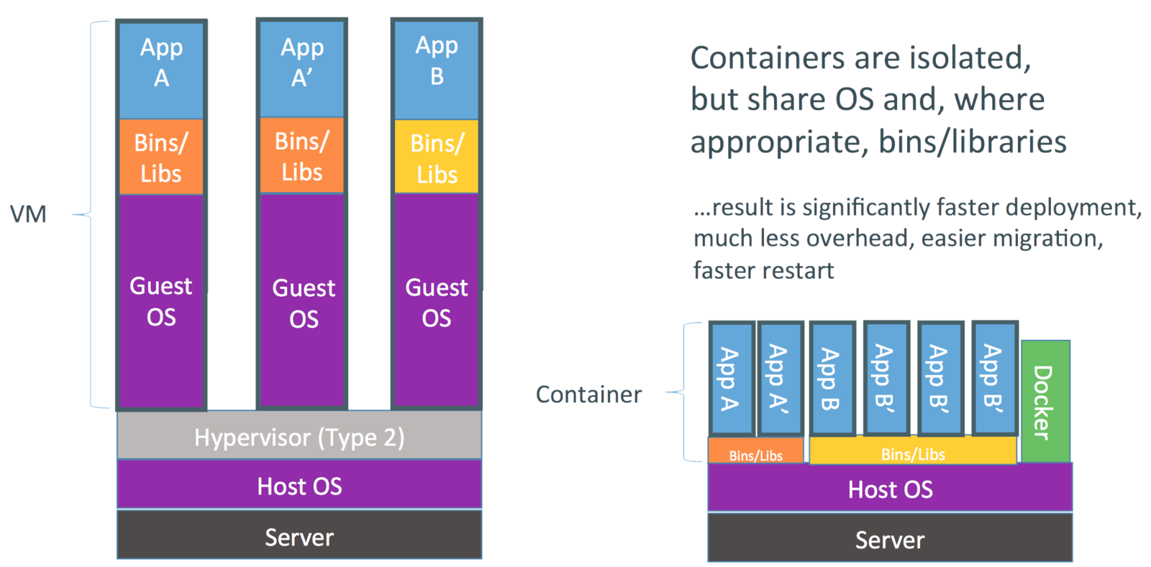

Slide 4
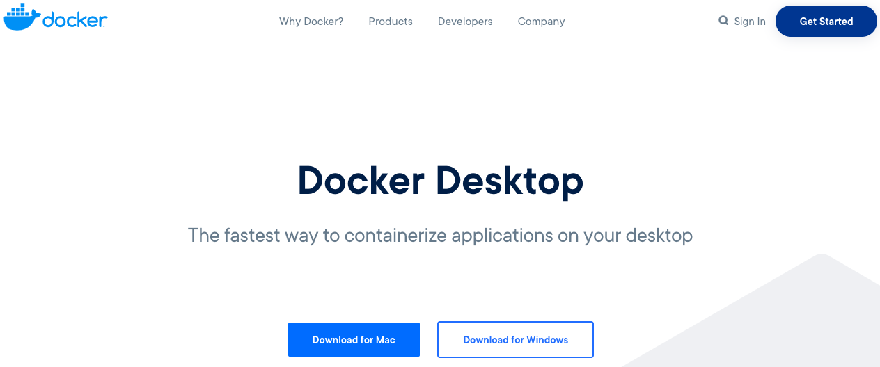
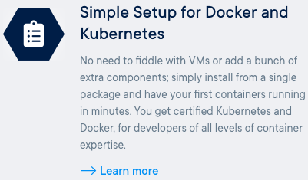
Installing Kubernetes
Easiest way to install Kubernetes and get up and running is using Docker Desktop.

Slide 5
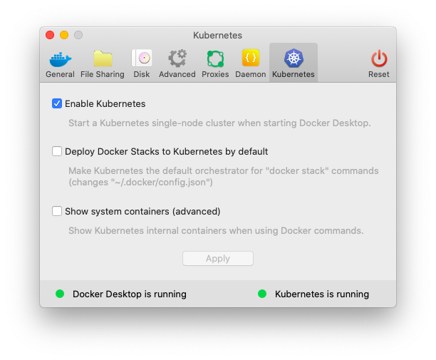
Enable Kubernetes
This will create a 1 node K8s cluster on your machine.
This installs both Docker & Kubernetes CLIs.
Run the commands:
docker version
kubectl version

Slide 6
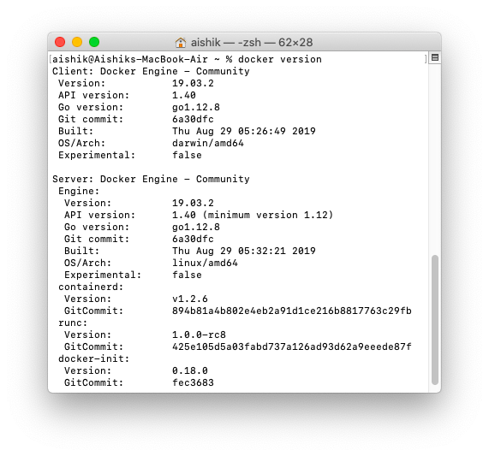
Run some commands
docker version
kubectl version
docker run hello-world

Slide 7

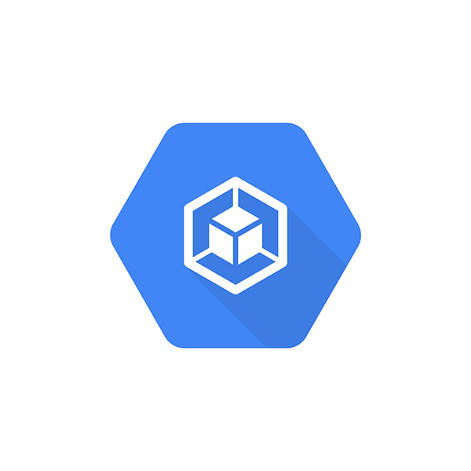
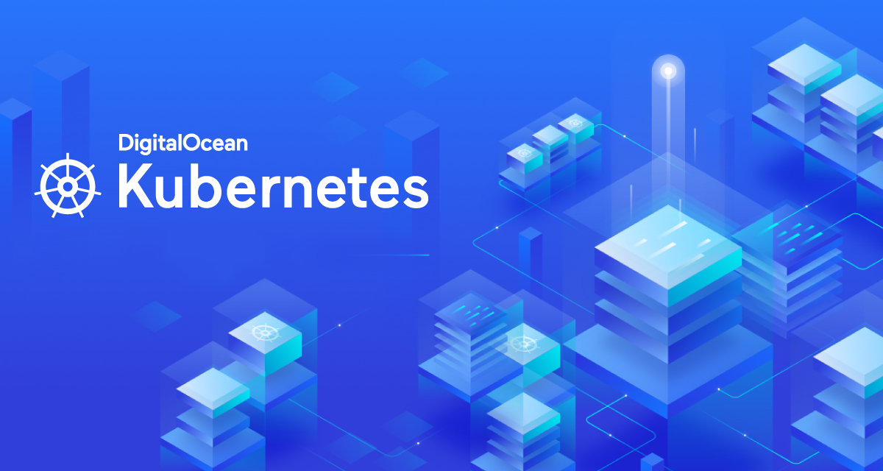

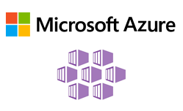
Other ways
AWS Elastic Kubernetes Service (EKS)
Google Cloud Google Kubernetes Engine (GKE)
Azure Kubernetes Service
DigitalOcean Kubernetes
katacoda.com

Slide 8
100%
Everything at Google runs in a container.
Source: https://bit.ly/3akkSdP

Slide 9
What can Kubernetes do for you?
With modern web services, users expect applications to be available 24/7, and developers expect to deploy new versions of those applications several times a day. Containerization helps package software to serve these goals, enabling applications to be released and updated in an easy and fast way without downtime. Kubernetes helps you make sure those containerized applications run where and when you want, and helps them find the resources and tools they need to work. Kubernetes is a production-ready, open source platform designed with Google's accumulated experience in container orchestration, combined with best-of-breed ideas from the community.

Slide 10
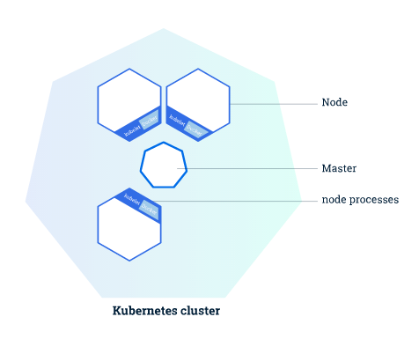
Check out the cluster
Kubernetes coordinates a highly available cluster of computers that are connected to work as a single unit.
A Kubernetes cluster consists of two types of resources:
Master - coordinates the cluster
Nodes - workers that run apps
Notes:
The abstractions in Kubernetes allow you to deploy containerized applications to a cluster without tying them specifically to individual machines.
Kubernetes automates the distribution and scheduling of application containers across a cluster in a more efficient way.
The master coordinates all activities in your cluster, such as scheduling applications, maintaining applications' desired state, scaling applications, and rolling out new updates.
A node is a VM or a physical computer that serves as a worker machine in a Kubernetes cluster. Each node has a Kubelet, which is an agent for managing the node and communicating with the Kubernetes master. The node should also have tools for handling container operations, such as Docker or rkt.

Slide 11
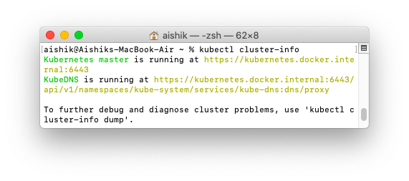
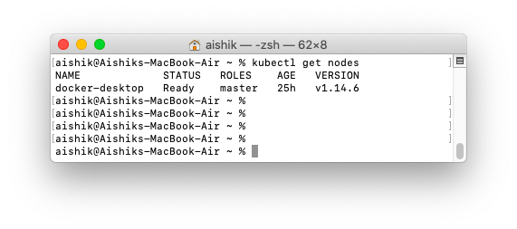
Run kubectl commands
Get cluster info
kubectl cluster-info
kubectl get nodes

Slide 12
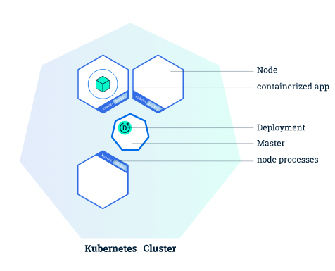
Create a deployment
Notes:
Once you have a running Kubernetes cluster, you can deploy your containerized applications on top of it. To do so, you create a Kubernetes Deployment configuration. The Deployment instructs Kubernetes how to create and update instances of your application. Once you've created a Deployment, the Kubernetes master schedules mentioned application instances onto individual Nodes in the cluster.
Once the application instances are created, a Kubernetes Deployment Controller continuously monitors those instances. If the Node hosting an instance goes down or is deleted, the Deployment controller replaces the instance with an instance on another Node in the cluster. This provides a self-healing mechanism to address machine failure or maintenance.

Slide 13
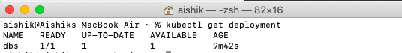
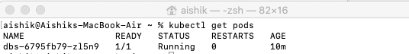

Slide 14
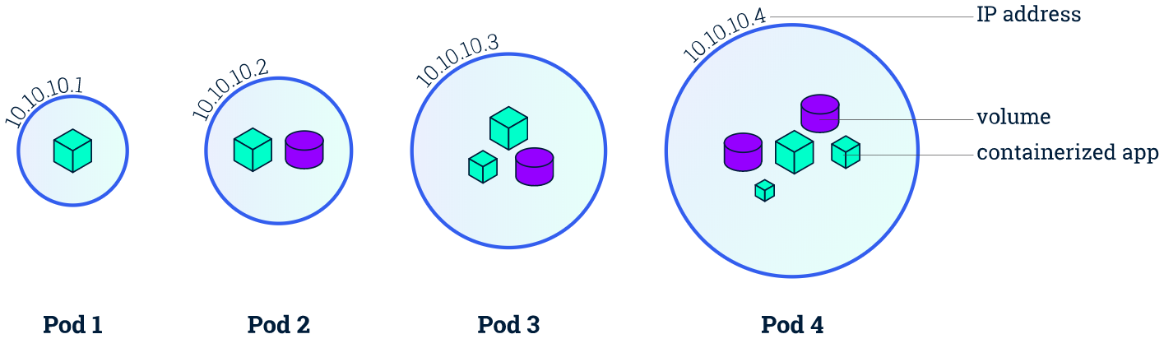
Pods
The previous Deployment created a Pod to host your application instance.
A Pod is a Kubernetes abstraction that represents a group of one or more application containers (such as Docker or rkt), and some shared resources for those containers.
Pods are the atomic unit on the Kubernetes platform.
Notes:
Once you have a running Kubernetes cluster, you can deploy your containerized applications on top of it. To do so, you create a Kubernetes Deployment configuration. The Deployment instructs Kubernetes how to create and update instances of your application. Once you've created a Deployment, the Kubernetes master schedules mentioned application instances onto individual Nodes in the cluster.
Once the application instances are created, a Kubernetes Deployment Controller continuously monitors those instances. If the Node hosting an instance goes down or is deleted, the Deployment controller replaces the instance with an instance on another Node in the cluster. This provides a self-healing mechanism to address machine failure or maintenance.

Slide 15
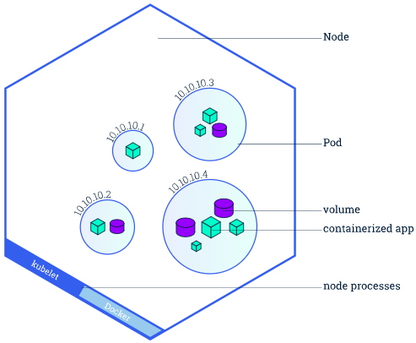
Nodes
A Pod always runs on a Node. A Node is a worker machine in Kubernetes.
Every Kubernetes Node runs at least:
kubelet
A container runtime (Docker, rkt)
Notes:
A Node can have multiple pods, and the Kubernetes master automatically handles scheduling the pods across the Nodes in the cluster. The Master's automatic scheduling takes into account the available resources on each Node.

Slide 16
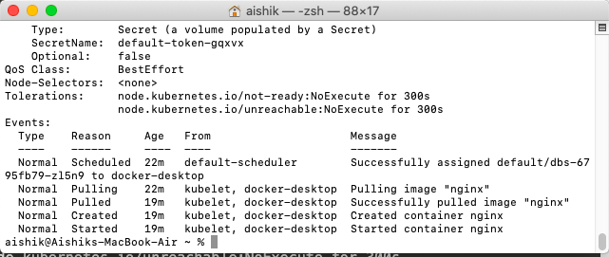
kubectl describe pods
This command provides a detailed summary of our pods.

Slide 17
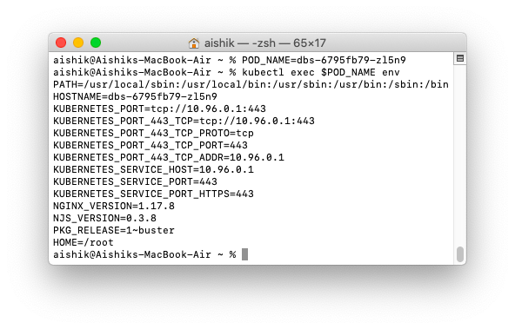
Run a command inside the pod
Run kubectl get pods to get the pod’s name.
Set the name to variable POD_NAME
kubectl exec $POD_NAME env

Slide 18
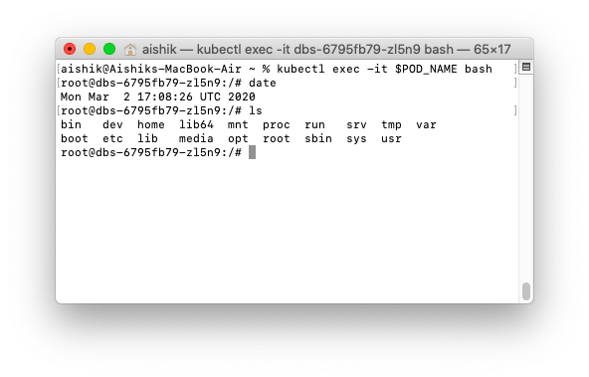
Start an interactive shell
kubectl exec -it $POD_NAME bash

Slide 19
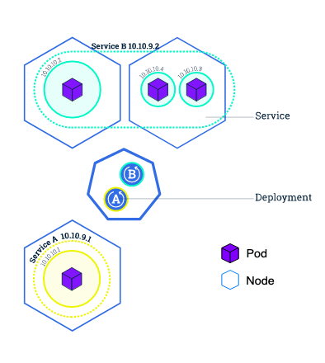
Services
Although each Pod has a unique IP address, those IPs are not exposed outside the cluster without a Service.
Services allow your applications to receive traffic.
ClusterIP (default) - Exposes the Service on an internal IP in the cluster.
NodePort - Exposes the outside the cluster.
LoadBalancer - Creates an external load balancer in the current cloud
ExternalName
Notes:
Kubernetes Pods are mortal. Pods in fact have a lifecycle. When a worker node dies, the Pods running on the Node are also lost.
A Service in Kubernetes is an abstraction which defines a logical set of Pods and a policy by which to access them.
Services are the abstraction that allow pods to die and replicate in Kubernetes without impacting your application.

Slide 20
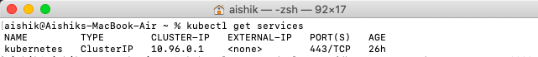
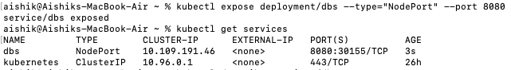
Expose a service
kubectl get services
Kubectl expose deployment/dbs --type=”NodePort” --port 8080

Slide 21
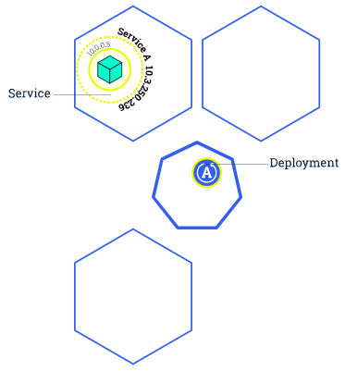
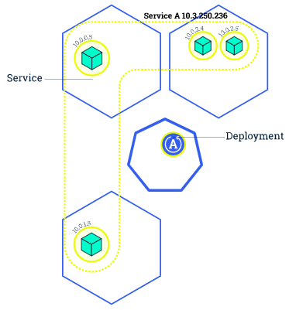
Scaling an application
In the previous modules we created a Deployment, and then exposed it publicly via a Service. The Deployment created only one Pod for running our application. When traffic increases, we will need to scale the application to keep up with user demand.
Scaling is accomplished by changing the number of replicas in a Deployment

Slide 22
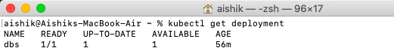
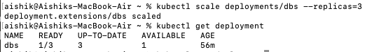
Scale up
kubectl get deployment
kubectl scale deployments/dbs --replicas=3
Done 😎
Notes:
Scaling out a Deployment will ensure new Pods are created and scheduled to Nodes with available resources. Scaling will increase the number of Pods to the new desired state.
Running multiple instances of an application will require a way to distribute the traffic to all of them. Services have an integrated load-balancer that will distribute network traffic to all Pods of an exposed Deployment.

Slide 23
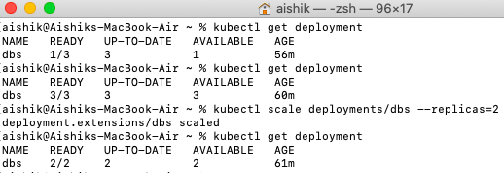
Scale down

Slide 24
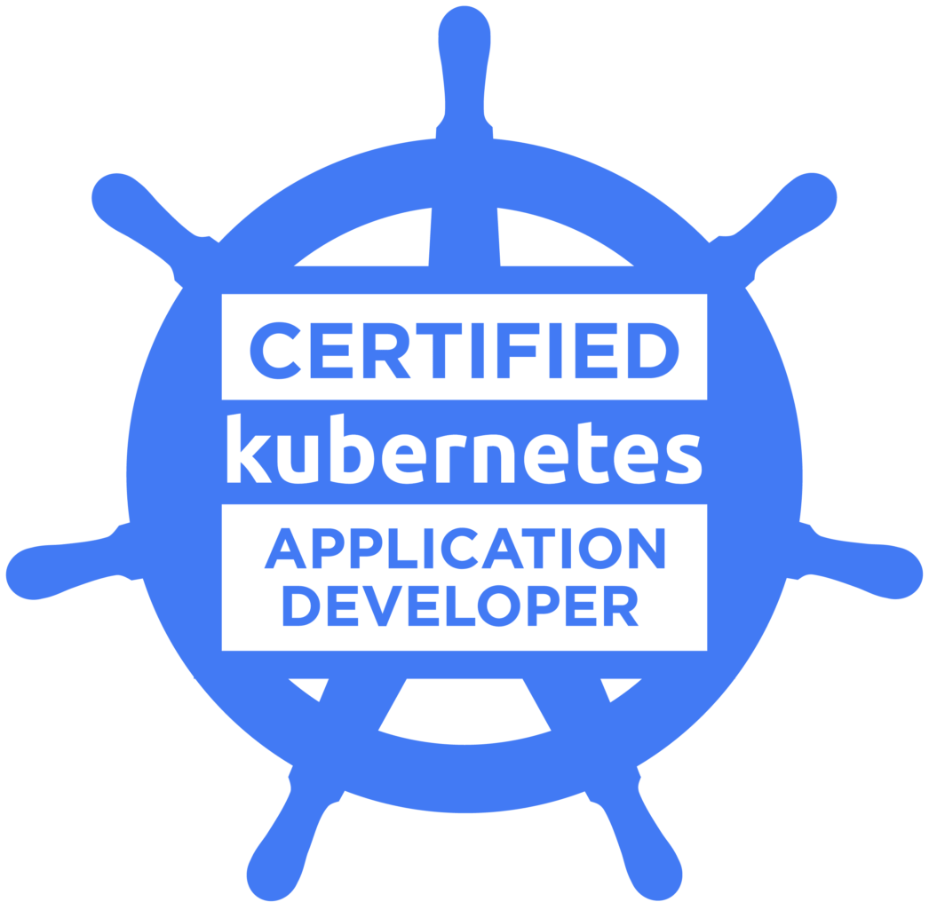
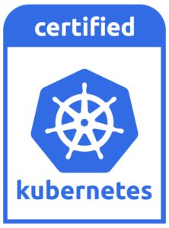
Kubernetes Certifications
CKA - Certified Kubernetes Administrator
CKAD - Certified Kubernetes Application Developer

Slide 25
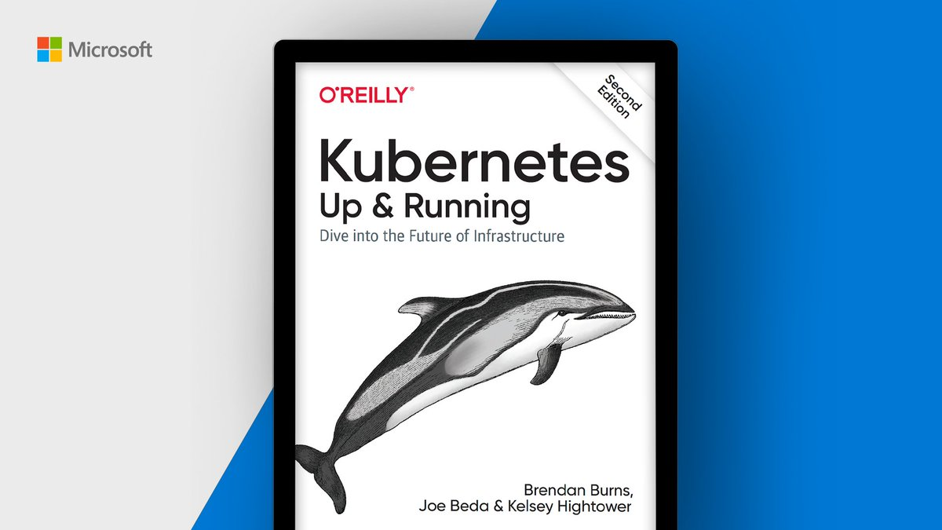
Kubernetes: Up and Running, Second Edition
https://tinyurl.com/k8sbook

Slide 26

Final point
A one-line description of it

Slide 27
“This is a super-important quote”
- From an expert

Slide 28
This is the most important takeaway that everyone has to remember.

Slide 29

Thanks!
Contact us:
Your Company
123 Your Street
Your City, ST 12345
no_reply@example.com
www.example.com

